Slide 1

Supporting Veterans and Student Service Members
Central Oregon Community College
2018

Slide 2
Student Service Members and Veterans want faculty to know...
No two veterans are alike.
We have normal reactions to an abnormal experience.
Do not assume that you know my POLITICS or my BELIEFS just because I was in the military.
Each of us has had different experiences.
I may or may not be ready to talk about my experiences.
TRUST
Can be an issue for me.
Being friendly & listening can go a long way toward building trust.
Do not be AFRAID of me.
We are accustomed to being successful and may be too proud to ask for help.
Notes:
Jane: What we know, what students wish we knew, and where we go from here.

Slide 3
Student Service Members & Veterans
Are mature, committed and hard working
Know the importance of finishing their education
May experience college campus life as chaotic
May get frustrated with bureaucracy
Do not like getting the run-around
May not be comfortable with people standing behind them
Have an instant connection between military members
May have doctor appointments that cannot change
AND
Are also like other students in many ways
Notes:
Jane:
Unique characteristics, but just like other students in many ways

Slide 4
The GI Bill and Community College: A Long History
How the GI Bill influenced the growth of community colleges
Since 1944, the GI Bill has produced:
14 Nobel Prize winners 12 US Senators
3 Supreme Court Justices 24 Pulitzer Prize Winners
3 Presidents of the United States 91,000 Scientists
Notes:
Jane:
Community Colleges have been at the forefront of almost every development in higher education
74 years since passage of the original GI Bill (15 million men; 350,000 women returning from WWII).
By 1947, 49% of all students were attending under the GI Bill; open access
As of 2017, 1,492 community colleges, an increase of over one thousand colleges since the 1960’s

Slide 5
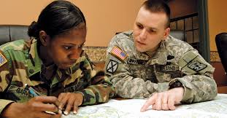
Veterans in Higher Ed
In 2009, ACE projected that 2 million Veterans would enroll in postsecondary education in the next decade
As of October 2013, the VA was serving 1 million Veterans enrolled in school and using VA benefits
New Projection is more than 1 million more in next 5 years
Notes:
Jane
~5.6 million students enrolled in community college in 2017

Slide 6
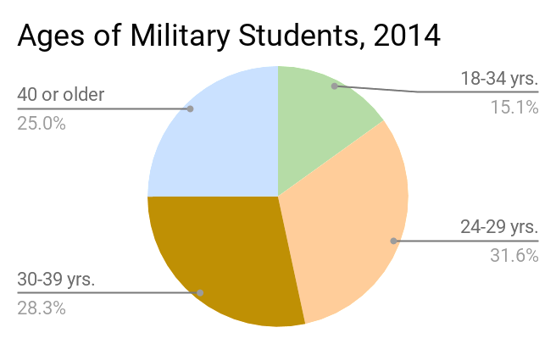

Veterans & Student Service Members in Higher Ed
Notes:
Jane:
According to the Million Records Project, Veteran and Active Duty Students tend to be older, more mature, and more dedicated to achieving a post-secondary degree or certificate.

Slide 7
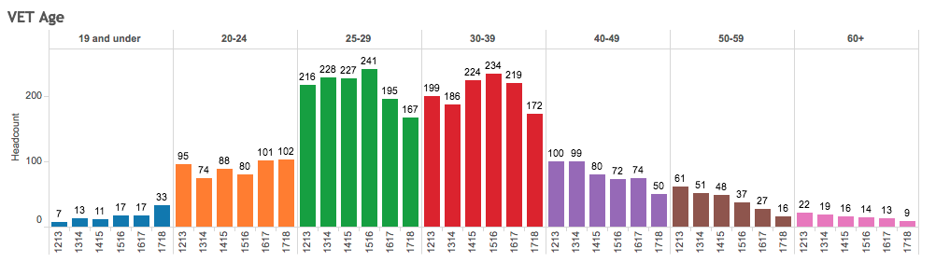
Average Age of Veteran Students at COCC, 2012-2018
Notes:
Jane
Similar to what we see at COCC

Slide 8
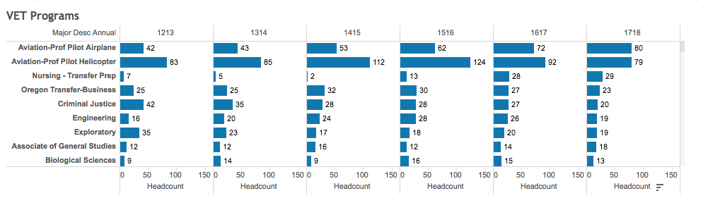
Programs that Veterans Enroll in at COCC, 2012-2018
Notes:
Jane
The programs Veterans enroll in

Slide 9
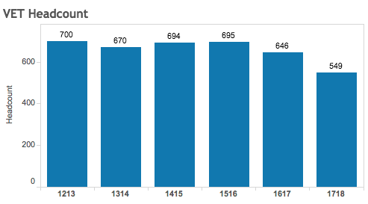
Number of Veterans Enrolled (self-reported) 2012-2018
Notes:
Jane
The decrease in Veterans has outpaced our decrease in enrollment, overall (~13% vs. just under 7%)

Slide 10
Who are Veteran/Student Service Member Students?
Nationally:
Ethnicity/Diversity
Female Veterans/Service Member Students
  73% are male; 27% are female.
47% of student Veterans have children; 47.3% of student Veterans are married.
Most student Veterans are enrolled in public 2-year (43.3%) and 4-year institutions (21.4%).
Notes:
Jane
Who are our Veteran and Service Member Students?
–OEF: Operation Enduring Freedom (Oct 7, 2001-present)
–OIF: Operation Iraqi Freedom (March 20, 2003-August 31, 2012)
–OND: Operation New Dawn (Sept 1, 2010-present)
–Operation Odyssey Dawn (March 18, 2011-present)
–Other Era Veterans

Slide 11
Survey Results
Overview
Conducted in March-April, 2018
11 questions
84 respondents
Jake
Notes:
Jake

Slide 12
Survey Results cont.
Age of COCC Vets: 30-49 (39%) and 25-29 (29%)
COCC Vets receiving VA Benefits: 75%
Most Vets are happy with “Vet tailored” services: 77%
76% reported having no academic issues connected to their Vet status
Of the 25% who encountered such issues, from their academic institution 58% received satisfactory assistance in solving those issues
Jake
Notes:
Jake

Slide 13
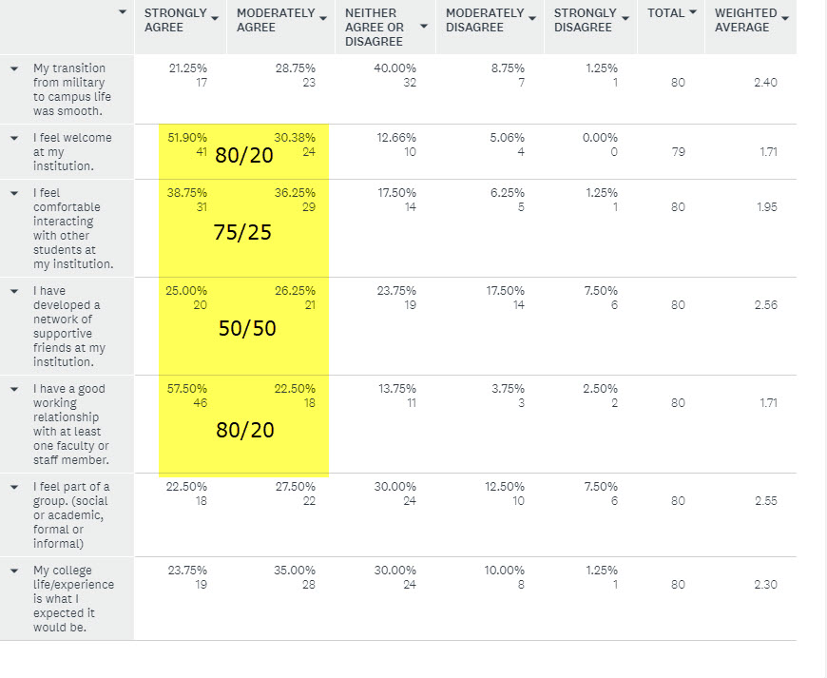
Survey Results cont.
Jake
Notes:
Jake

Slide 14
Survey Results cont.
Q10 Would you be willing to offer a personal recollection that illustrates the type of experience you've had regarding transitioning from the military to college? The anecdote can relate a positive experience or a negative experience and may elaborate on your answers to Questions 8 and 9.
The hardest part of getting off of active duty is the loss of purpose and feeling of “what now” that
over comes you. The other hard part is just being the older person with life experience listening to
kids whine about how hard life is at 18.
Connecting with other veterans is very easy. Some younger students are very thankful but seems most of the younger students would rather turn their noses up to us veterans. It seems more
prevalent on college campuses than it does in the community. In many of my classes I'm
uncomfortable speaking out of fear that my occupation in the military will offend my classmates.
Instructors should be made aware of a particular student status, enrolled in their class, such as a Veteran! An older, aged student an Veteran such as myself would have an should have VIP status than any other ordinary, typical student.
COCC and its staff have been instrumental in assisting me with my educational goals. The trials
and tribulations I've encountered have been due to the Department of Veteran Affairs. Being
accepted and enrolling through Vocational Rehabilitation has taken me years to get where I'm at now. If Chapter 33, the Post 9/11 GI Bill, is the brand new Cadillac of educational assistance than Chapter 31 is a broken down, rusted out Hyundai that barely runs. I spent more years getting approval for school from the VA than I spent on active duty in the military.
The lapse in time between the first terms tuition deadline and the date in which I was able to
receive G.I. benefits was long enough to cause added stress during what was presumably the
most stressful time of my student life.
After retiring from the Army as a senior Non-Commissioned Officer with 30 years experience, I shouldn't be required to take small group leadership. There are many other classes that my military transcript should have been able to satisfy. but they get applied to course I am not even vaguely interested in taking!!!
Figuring out how the CTE credits awarded for my military service applied toward my degree/ financial aid eligibility was difficult. The VA is astoundingly difficult to deal with, especially
on my own. The veterans representative was helpful, but in my opinion she was also entirely too busy to provide the level of assistance required of young, transitioning veterans.
Jake
Notes:
Jake

Slide 15
Typical*Challenges for Veteran Students
62% are First Generation College Students (Kim & Cole, 2013)
Non-Traditional Students (Whiteman, Barry, Mroczek, MacDermin & Wadsworth, 2013)
66% struggle with supporting self & family (National Center for Veteran Studies)
20% of all Veterans had a service-connected disability (Bureau of Labor & Statistics, 2015)
3-20% Enlisted Military Personnel have a learning disability (Grossman, 2018)
Challenges:
Transition/Readjustment
Administration/Bureaucracy
Academics
Social Relationships
Notes:
Sara
Remember: not everything applies to all Veteran students - they are all unique individuals and not a monolithic group
Intersectionality - Student Veterans share challenges
Transition issues include: Moving from structured to unstructured environment, loss of sense of mission and purpose, anxiety, insomnia, paranoia, startle response, PTSD, TBI
School Administration: dealing with & coordinating VA benefits and School Financial Aid, Managing payments and deadlines, transfering credits (ave # of transfer credits for 2 year student = 12)
Academic Performance: Self-Sufficiency - don’t like to ask for help; VA Toolkit: Veteran students spend more time preparing for class and more time outside of class with instructors than civilian students but less time engaged in experiential learning opportunities such as internships and practicums; Differences between military & education definition of disability
Social Relationships: Can be challenging to find “like-minded peers” on campus; Frustration with perceptions of younger students being less motivated or dedicated, disconnection from experiences of “traditional” student experiences, biases against military, being asked to speak for all veterans and/or being asked innapropriate questions about service

Slide 16

Disability Services and Student Veterans
90% in the survey stated “N/A” in that accommodations in the classroom don’t apply to them. Why not?
(Even though 40% of all Afghan and Iraq Veterans meet the legal definition of an individual with a disability)
(Grossman, 2018)
Notes:
Jamie: Following up from the survey results, an astonishing note was that 90% in the survey thought or felt that accommodations didn’t apply to them. Any thoughts on why that is? Because look at this next statistic from Paul Grossman, who has done a ton of research on Veteran Centers across the nation and what makes them successful on college campuses. 40% would qualify!

Slide 17
Why don’t Veterans seek assistance?
Delay in receiving VA paperwork with disability documentation information
Stigma in ‘asking for help’. Military trains to be independent and get the job done.
They don’t identify as being someone with a ‘disability’
Setting up an appointment (bureaucracy steps)
One reply to the survey question if they have ‘had a negative experience with accommodations’: ‘It’s more my own failure to reach out.’
Notes:
Jamie: These are the top 3 that I hear the most when a Veteran eventually comes to my office to meet. I do have a contact # that I can give Veterans who need (brief) documentation of a disability diagnosis, who then quickly looks it up, and sends to the student. The 2nd point is the one I hear the most. They have had intense training about following orders and getting the job done. Asking for help is not in their training. During the appointments I hear “this was really difficult for me to do.” I rarely see Veterans in the beginning of the term, and only after they are having difficulty and are referred by an instructor. The 3rd is that they aren’t quite sure that they even have a disability. There’s a lot of pre-conceived notions about what a ‘disability’ is (physical limitations).

Slide 18
Disability Services
Most common diagnosis Accommodations
Cognitive Impairments PTSD (Post Traumatic Stress) TBI (Traumatic Brain Injury) | Service Animals, preferential seating, flexible attendance Memory Aids
B. Physical Impairments Low Hearing, Tinnitus Low Vision Orthopedic (back injury, mobility limitations) | Note taking Recording Lectures, Audio Books ADA furniture, ADA shuttle
C. Combination of A & B or Secondary Anxiety Depression Learning Disabilities | Extended Time on timed assessments, reduced distraction Digital Copies to use with ReadSpeaker
Notes:
Jamie: These are the most common diagnoses I see for Veterans, and examples of accommodations that they may qualify for. (Depending on time, review a few of these).

Slide 19


Services that Help Veterans & Student Service Members on Campus
Properly trained faculty
Peer Mentoring services
Affordable housing
Transparent information for informed decision-making
Creating checklists to help students walk through the process of enrolling, engaging benefits, accessing support services, checking grades, etc.
Notes:
Sara -
School websites
Applications
Student Orientation
Credits
Tuition, Fees, & Scholarships
Veteran Groups
Veterans Day

Slide 20
Veterans Education Benefits
Types of VA Benefits Available
  Chapter 33, 35, 30, 31, 1606, Tuition Assistance (TA)
Enrolling and Engaging Benefits
Dropping/Changing Classes
Short-term Classes
Requesting Certification
Veteran Window Hours
  Boyle Education Center
  Monday - Thursday, 9:00 am - 5:00 pm
Notes:
Sue:
Types of VA Benefits Available:
6 different education benefit chapters.
Each Chapter is different, with different payment structures and qualification requirements.
Students’ eligibility and benefits can vary greatly from one student to another. Have them come see us.
Enrolling and Engaging Benefits:
Students must complete VA required paperwork when first accessing benefits.
We have a checklist to help guide students on required paperwork.
We begin intake of paperwork and benefits enrollment after students are registered in classes.
We prefer to do this in person to make a connection. It also allow us to explain their benefits, requirements, and what to expect in detail.
For all chapters of benefits:
Classes must be required for the student’s degree.
Classes must be at or above test level. Won’t cover remedial classes online.
12 credits is considered full time.
It can take the VA 30 days to process paperwork. This can cause frustration for the student, especially if it delays payment.
Students may be eligible for federal financial aid in addition to their Veteran’s education benefits.
Dropping/Changing Classes:
Dropping a class outside the refund period will create a student debt with the VA.
Changing a class can create a debt if the class is not required, if student drops below full time, or if class is dropped after refund period.
Students should always check with us before they drop or change a class and should always notify us of any change made after they’ve requested certification.
Short-term Classes:
Short-term classes are only counted toward total credits during the time class is in session.
Requesting Certification:
Must be requested every term, AFTER student is registered in classes.
Not all students choose to use their benefits each term.
Can request certification online through Bobcat Web Account, or in-person at the Veterans window.
Veteran Window Hours: Please direct veteran students to us for questions or issues. We want to help! Our window hours are M – Th, 9 -5. Fridays the window is closed, but we are available by phone or email.

Slide 21

Helping Student Veterans in the Classroom
•May prefer to sit in the back of classroom
•May avoid having back to the door
•May appear distracted/trouble with memory
•May leave classroom unexpectedly
•May be irritable in class discussions
•May miss class
•May appear sleepy in class
Notes:
Sara? Or Jane or both
Best practices for students with access needs and learning challenges are actually best practices for all students; most of this is also true for working with student Veterans

Slide 22
What Not to Say:
What was going to war like?
Did you see anyone die
Did you kill anyone?
Would you go back?
How was Iraq/Afghanistan?
How did you get injured?
What was going to war like?
Did you see anyone die
Did you kill anyone?
Would you go back?
How was Iraq/Afghanistan?
How did you get injured?
Notes:
Sara
Knowing want not to say and when to intervene in classroom conversations is important.

Slide 23
Be Culturally Sensitive
Comments that are appreciated:
•“Thank you for serving” •“Thank you for your service to our country” •“Welcome back” •Thank their family for their service in supporting their Service-member
Ask questions that can get factual answers:
When did you get back?
What unit were you with?
What branch of the service are you/were you in?
Keep in mind:
Don’t Pry. If they don’t want to talk don’t push it.
Don’t go overboard in praise or thanks to the veteran.
Simplicity is the key.
Notes:
Sara
Conversely, knowing what to say and modeling this can make a difference.

Slide 24
What to do:
Statement of Veterans Support for Your Syllabus: Veterans and active duty military personnel with special circumstances (e.g., upcoming deployments, drill requirements disabilities) are welcome and encouraged to communicate these, in advance, if possible, to the instructor.
Be clear and concrete with due dates and assignment expectations. Veteran students may be task-oriented.
Be flexible with teaching methodologies.
Be cautious of sudden sounds/changes; announce changes.
Be aware of classroom environment; Veteran students often prefer a “secured” classroom space (physical and emotional).
Effective classroom policies are often appreciated.
Notes:
Sara

Slide 25
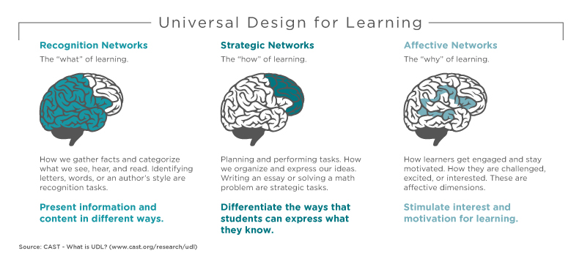
What to do: Universal Design for Learning
Notes:
Sara
Allow adaptive technology- note taking pens, recording
Give test with word limits vs. time limits
Make class notes available to all students
Use Blackboard Ally to ensure your documents are accessible
Ensure classroom and field trips are mobility accessible

Slide 26
Projects for COCC
Short & Mid-Term:
Green Zone Program (modeled after Safe Zones Program)
Create a COCC Veterans Services “Getting Started” Check List, Data Form, Veteran and Service Member Students Statement of Rights & Responsibilities (based on the DoD MOU)
Create a COCC Veterans Website and Contact Sheet with Important Phone Numbers & Web Resources
Long Term:
Hire a part-time FTE Coordinator for Veterans Services
Veterans Safe Space Training (we suggest Green Zones)
Redesign website and marketing tools to recruit/retain veteran and service member students
Evaluate Registration Barriers
Expand Veterans Lounge into more robust Veterans Center
Notes:
Additional Goals: Accepting transfer credit for military training/experience

Slide 27
Faculty Resources
VA National Center for PTSD Website Faculty Resources: www.ptsd.va.gov
Fact sheets, videos, web resource links, and more.
Returning from the War Zone Guides: http://www.ptsd.va.gov/public/reintegration/guides-rwz.asp
Full color PDFs in versions for Military personnel and families with narratives. Includes a Flash interactive multimedia presentation
Understanding PTSD: http://www.ptsd.va.gov/public/pages/fslist-ptsd-overview.asp Learn what PTSD is, and what it is not. Hear real stories of people dealing with PTSD. Includes an interactive online format as well as a full color PDF handout.
VA PTSD Program Locator: http://www.ptsd.va.gov/public/where-to-get-help.asp Find a VA PTSD treatment program near you.

Slide 28
Student Resources
After Deployment: http://afterdeployment.dcoe.mil/ Wellness resources for the military community.
Military OneSource: www.militaryonesource.com Free service provided by the Department of Defense for active-duty, Guard, and Reserve Service Members and their families, topics include education, relocation, parenting, stress.
National Resource Directory: www.nationalresourcedirectory.org *. Over 11,000 resources for wounded, ill or injured Service Members and their family.
Real Warriors: www.realwarriors.net *. Promotes the processes of building resilience, facilitating recovery and supporting reintegration of returning Service Members, Veterans and their families
Returning Service Members: www.oefoif.va.gov *
Student Veterans of America: www.studentveterans.org *. National organization that helps develop student Veteran groups on campuses and develop programs and policies to assist with Veteran transition to the classroom.

