Slide 1
Open Education Resources: what, why, how?
Tina Hovekamp
Annemarie Hamlin
Chris Rubio
A number of slides and images for this presentation were adopted with permission from:
Open Education Resources: Librarians as Advocates, Advisors, and Creators by Mary Ann Cullen, CC BY-NC 4.0
:

Slide 2
Poll: Rate yourself
1.Novice
2. Emerging
3. Pretty good
4.Pro
OER?
Just getting going
Could use some advanced knowledge
Expert
Image derived from Open Educational Resources: Librarians as Advocates, Advisors, and Creators by Mary Ann Cullen, CC BY-NC 4.0

Slide 3
What we’ll cover
Definition of OERs
Creative Commons licensing
Creating an OER
Why OERs?
Oregon’s response
Faculty concerns
Resources/ Exploration

Slide 4


OER Defined
OPEN | EDUCATIONAL | RESOURCES
“Open” = Openly licensed Public domain or copyright holder has waived some rights (e.g.,Creative Commons License) Do not need permission to... Use Distribute Modify/Remix Attribution to author usually required Free/cheap (e.g.,cost of production for print copies) |  | Kinds of resources include images assignments chapters textbooks courses Format - often electronic, but not necessarily e-text video anything
“PhD Tam of Awesome” Photo by Sara Cady https://flic.kr/p/7n7dPi

Slide 5
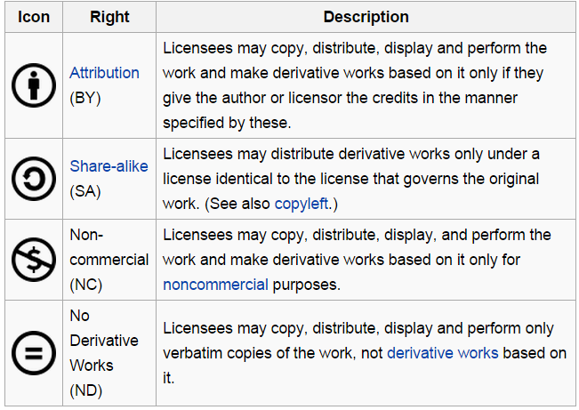
Creative Commons Licensing – what do these symbols mean?
Image from “Creative Commons license” Wikipedia. https://en.wikipedia.org/wiki/Creative_Commons_license

Slide 6
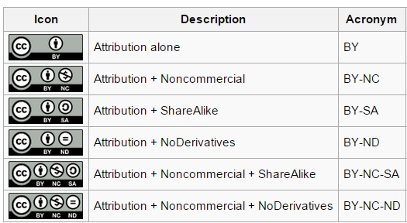
Creative Commons Licensing – example combinations
Image from “Creative Commons license” Wikipedia. https://en.wikipedia.org/wiki/Creative_Commons_license
http://creativecommons.org/

Slide 7
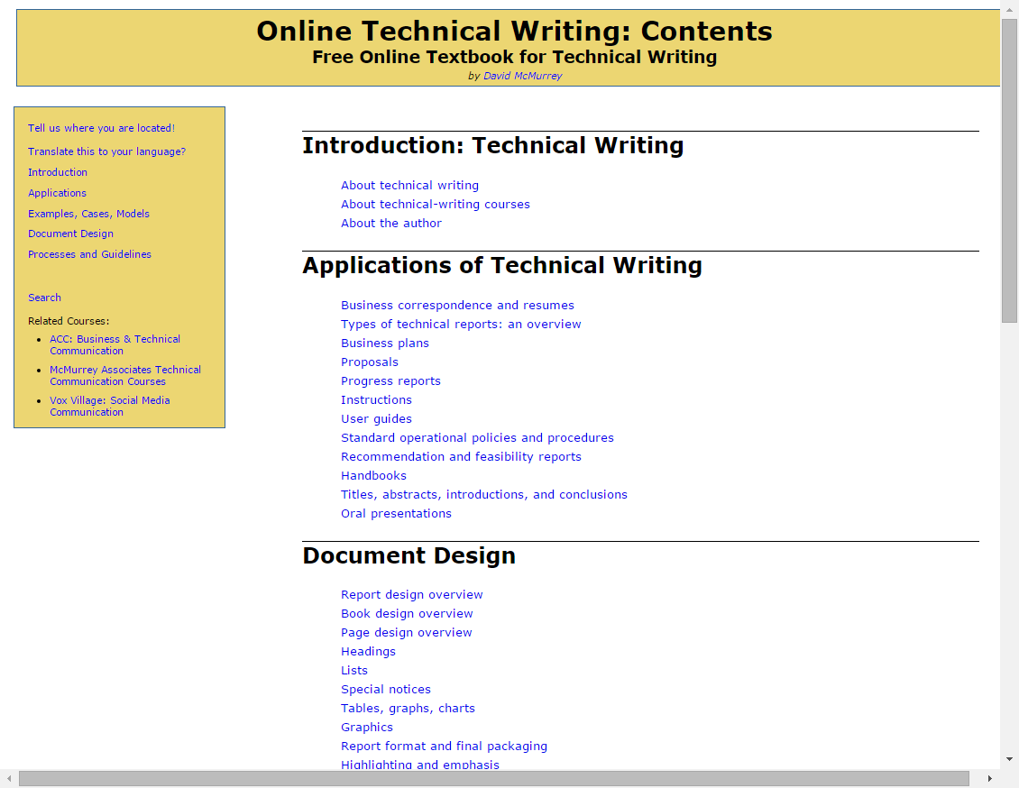

Example of OPEN

Slide 8
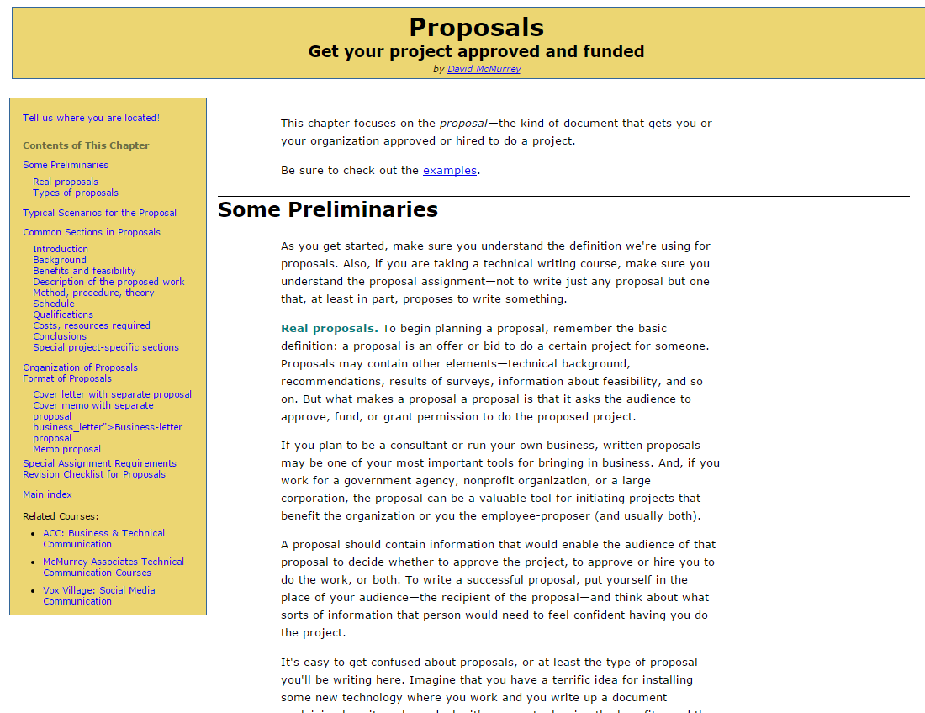
One example of open resource that can be modified/remixed

Slide 9
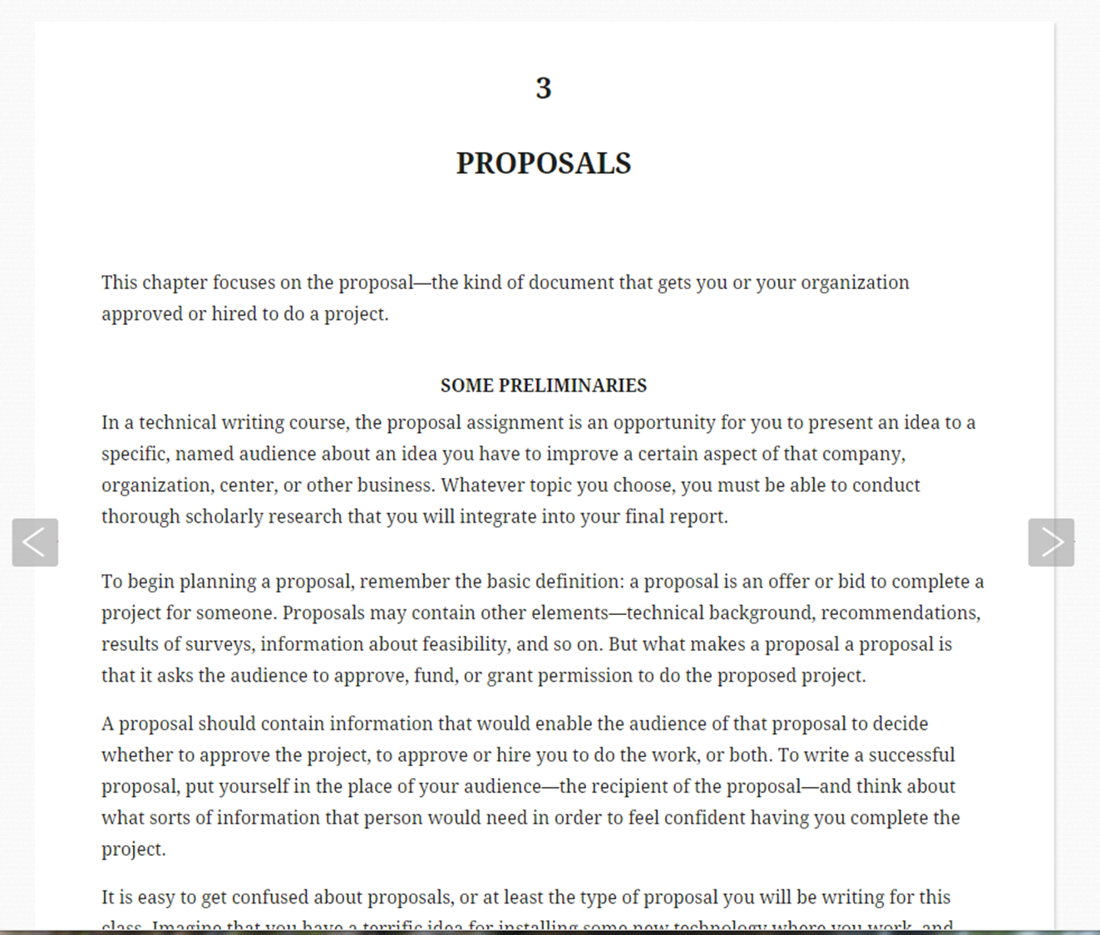
Here is what we did for WR 227 with the open source to make it our own

Slide 10

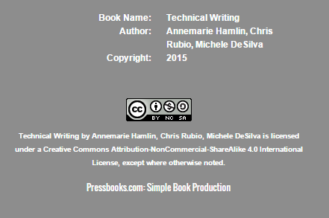
Our permissions
Creative Commons
  Attribution
  Non-Commercial
  ShareAlike
  4.0
Our opening page

Slide 11
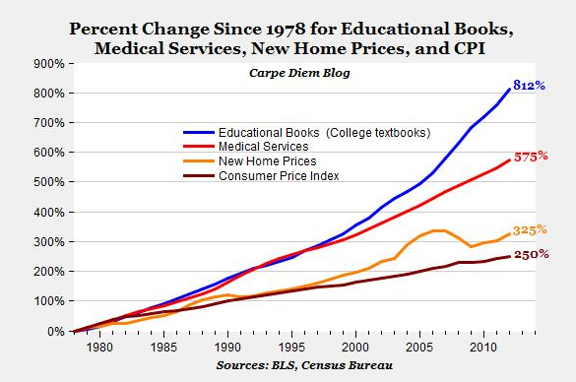
Why OERs?
$1168.
/student /year
From Mark J. Perry at the AEIdeas blog
http://www.aei.org/publication/the-college-textbook-bubble-and-how-the-open-educational-resources-movement-is-going-up-against-the-textbook-cartel/
College Board reported in Huffington Post
http://www.huffingtonpost.com/2013/01/04/college-textbook-prices-increase_n_2409153.html

Slide 12

Student response to high cost of textbooks:
Student response:
65% didn’t buy textbook due to cost
48% text cost affected # of courses
82% said they’d do better with free text
UNITED STATES PUBLIC INTEREST RESEARCH GROUP report: http://uspirg.org/reports/usp/fixing-broken-textbook-market
Image: Girl with Books by College360 https://flic.kr/p/cEHvLj

Slide 13

Savings to WR 227 students at COCC
3-5 sections of WR 227 each year
156-260 students each year
Textbooks cost about $75 per student
Savings to students:
$11,250 - $19,200
per year

Slide 14
OER benefits
Fewer drops
Adopt to class
Immediately available
Free textbooks as marketing tool
Easily updated
Serve as a marketing tool
fewer refunds + performance based funding

Slide 15
Oregon’s response
House Bill 2871 (2015)
Open Oregon OER Grants by the Oregon Community College Distance Leaning Association (deadline is January 29, 2016!) – see http://openoregon.org/call-for-proposals-open-educational-resources-grants/

Slide 16
Faculty Concerns
2144 faculty:
Locating
Evaluating quality /effectiveness
Uncertainty about permissions
Support materials
(points 1,2,3): Babson Survey Research Group: Opening the Curriculum: Open Educational Resources in U.S. Higher Education, 2014

Slide 17
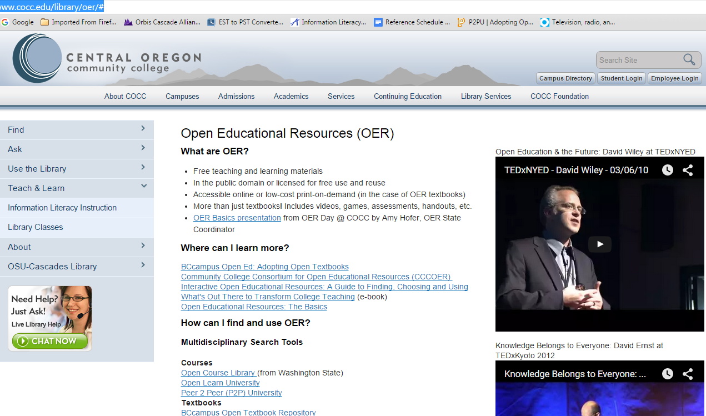
Important Resources
Write this down!
http://www.cocc.edu/library/oer

Slide 18


Search Sites for OER Texts
http://open.umn.edu/opentextbooks
http://openstax.org
http://open.bccampus.ca/find-open-textbooks/

Slide 19


Other Search Sites for oer materals
https://www.oercommons.org
http://www.merlot.org

Slide 20

Questions? Comments?
Let’s explore!
Question Mark Cookies 3 by Scott McLeod - https://flic.kr/p/bTQwfx

Slide 21
For support and help you may also contact:
Amy Hofer, OER State Coordinator for OpenOregon
hofera@linnbenton.edu

