Slide 1
Reworking a lesson, an approach, or a syllabus assignment
Anti-Racist Pedagogy

Slide 2
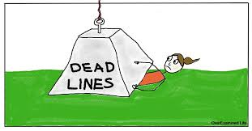
Equitable Deadline Ideas
2 day grace period
Creating the late policy in collaboration with students
Drop assignments --a free pass for an assignment
  (Extra credit if they don’t use it)
If the extension is granted--student’s responsibility to add a note to the assignment as a reminder
Considerations: It’s late work but student went to the Writing Center/Tutoring, did something additional
Being consistent on date or turn in times

Slide 3
Checklist for Decolonizing your syllabus

Slide 4
Resources to create your own checklist
Short checklist for Decolonizing the Syllabus-Mercer University
Checklist of Inclusive Excellence-University of Denver
A long checklist focused on a psychology syllabus

Slide 5
Accessible Syllabus
Don’t forget about Accessibility!

Slide 6
Resources for an Accessible Syllabus
Accessible Syllabus- Tulane University
Accessible Syllabus Checklist-Austin Peay State University
Creating Accessible Content-Portland Community College

