Slide 1
Building on a Tradition of Excellence
Exploring the Beginning of Early Childhood Education

Slide 2
Announcements & Updates

Slide 3
Early Childhood Education has a rich history
By looking at trends and areas of interest, we see connections between what was relevant 150 years ago and what is important currently.
Pervasive questions and topics:
What are the goals for children’s learning and development?
What types of environments and materials are most meaningful?
How should we teach children?
What is the role of teachers?
How do we involve families?
What does a teacher need to know in order to teach?

Slide 4
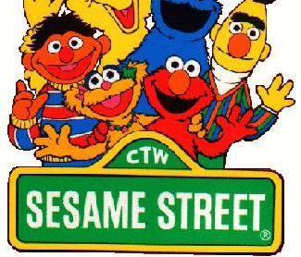
What about the influences in our own early learning?
As we consider the years of our own early childhood, what are some of the cultural, historical, political, social factors that may have contributed to our experiences?
What about the factors that shaped our parents, grandparents, and teachers’ experiences in their education?

Slide 5
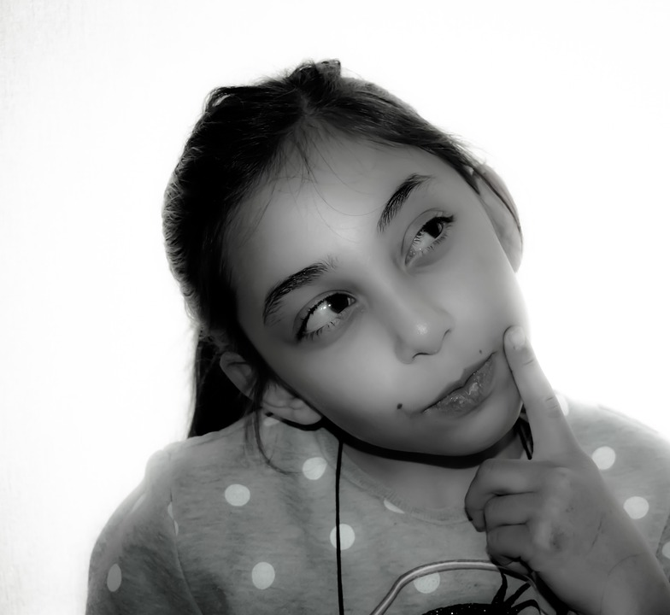
What are some of the elements that likely shaped your early childhood education?
Social factors
Cultural events
Political climate
Historical influences

Slide 6
Acknowledging without getting stuck
“Many of the principles and values that guide the field today are remarkably consistent with earlier views….there are also essential differences based on newer research, theories, and realities.” (Bredekamp)
Our history is not just a story of events, policies, laws. It is a history of of people, of all genders and lived experiences, who have contributed to our field.
Learning about early contributions must include acknowledgement of the social, political, historical conditions, beliefs, biases of the time.

Slide 7
Examples of a winding path: Change and Direction are not Consistent
Providing services for children as a national priority
Supporting families in the early years
Providing access to nutrition and healthcare
Establishing clear guidelines for teacher preparation
Providing a high living wage for educators
Family engagement in children’s learning and development
In each of these examples, we see evidence in support and evidence that challenges.
This Photo by Unknown Author is licensed under CC BY-NC-ND

Slide 8
One Significant Area of Change: How are children viewed?
How do our views about something impact behaviors?
How do our views about something impact our decisions?
How do our views about something impact our values and commitments?

Slide 9
Children as Miniature Adults
The Graham Children by William Hogarth (1742)
Notes:
The Graham Children is a conversation piece,^{[3]} an informal group portrait of family or friends, often engaged in conversation or some other kind of activity,^{[4]} though the painting is larger than a typical work of that type. From left to right in the picture are Thomas, born 1740 and dressed in skirts as was typical for small boys until they were breeched, Henrietta, Anna Maria and Richard.^{[5]}
Infant mortality in Britain was high in the eighteenth century, even for the children of the wealthy, and Thomas had died before the painting was completed.^{[1][6]} Hogarth used a study, probably completed after Thomas's death, as the basis for his image. With its numerous references to death and the passage of time, it may be that the painting is a form of memorial for Thomas.^{[6]}

Slide 10
Why babies in medieval paintings look like ugly old men?
Most of medieval babies were depictions of Jesus. The concept of the homuncular Jesus affected how children were portrayed.
Church commissioned
Medieval concepts of Jesus were deeply influenced by the idea of preformation and homunculus, which literally means little man. Idea that Jesus was fully formed, complete, mature
By Phil Edwards@PhilEdwardsIncphil.edwards@vox.com Updated Jul 28, 2015, 9:26am EDT

Slide 11
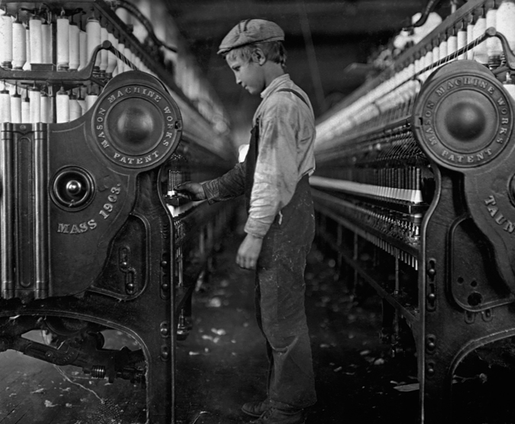
Implications of a world in which we see children as smaller versions of adults?
What else was happening prior to 18th Century?
Mortality rates
Integration of education and religion
Social and economic mobility
Role of families
Role of school
Expectations
Social
Emotional
Economic
This Photo by Unknown Author is licensed under CC BY-SA

Slide 12
A thing of the past?

Slide 13
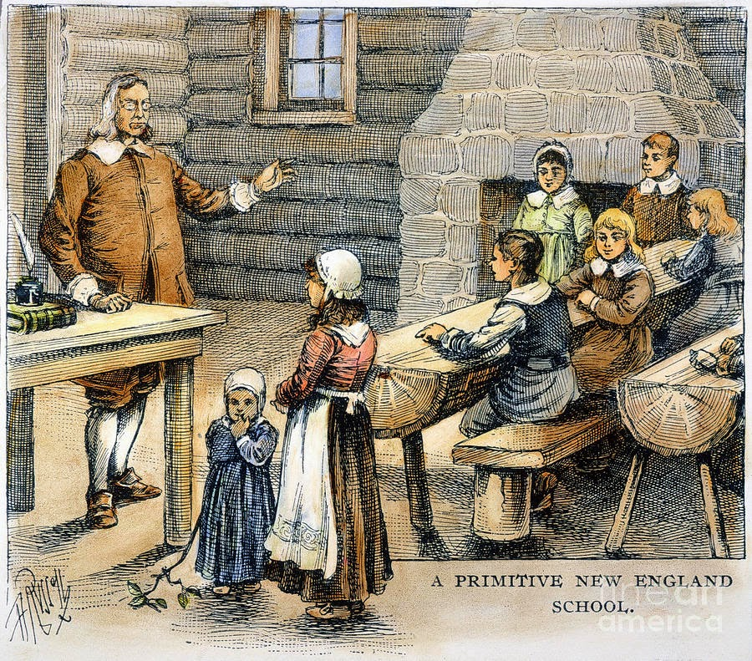
Beliefs that Children need Redemption
1300s-1800s beliefs that children were born in sin
Misbehavior viewed as evidence
Punishment viewed as critical to better life
Roles of schools closely linked to church teachings
Focus on moral character
Scholarly values linked to religious ideals
Among earliest examples of arguments used to rationalize abuse inflicted against children

Slide 14
[Elementary school children standing Eland [Elementary school children standing and Elementary school children standing and watching teacher write at blackboard, Washington, D.C. (circa 1899)

Slide 15
Other images of children through the ages
Children as “blank slates” (John Locke)
Children as Innocents
Children bring economic value
Children are competent, active participants in their own learning
Children are citizens with rights
How does each idea inform expectations, behaviors, interactions, and policies?

Slide 16
Exploring the relationship between beliefs about children and education (European Influences)
Rousseau
Comenius
Head Start
Piaget
Pestalozzi
Froebel
Montessori
John Locke
Jean-Jacques Rousseau (1712-1778) and the idea that children are innocent, inherently good, and have infinite potential.
Influence on John Amos Comenius and Pestalozzi

Slide 17
How ideas flow, change, grow
(Rousseau) Importance of observing children, stages of development
(Comenius) Learning should be active and enjoyable. Teachers should follow children’s lead. Children need literature for children.
Head Start
Piaget
(Pestalozzi) Belief that all children can benefit from education. Teachers need a background in child development.
Froebel
Montessori
(Locke) Early experiences matter, early environments shape children’s learning
NAEYC: Developmentally Appropriate Practice
Constructivism

Slide 18
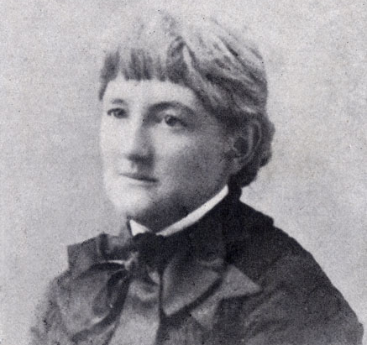
Important Movements, Individuals, Stories
First kindergarten in the United States was founded by Margarethe Schurz in Wisconsin in 1856. Early connection with Elizabeth Palmer Peabody. (Sister-in-law to Horace Mann- “Father of Public Education”
Susan Blow (1843-1916) founded first public kindergarten
Expressed early concern about how kindergarten would fit within public school: concerned that the “formality of the grades would seize kindergarten in its grip.”

Slide 19
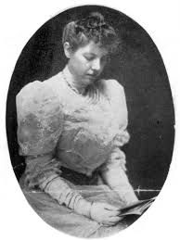
Patty Smith Hill (1868-1947): A life parallel to ECE’s
Progressive family: equal opportunity to learn for all children
An early student in Kindergarten
Emphasized value of play
Learned from Stanley Hall about child development
Created materials for learning (Happy Birthday!)
Racial and social justice
Early foundation for today’s early childhood practices
Founder of today’s NAEYC
This Photo by Unknown Author is licensed under CC BY-SA

Slide 20
Maria Montessori
1870-1952
Italy’s first female physician
Background with children living in poverty
Image of child as active, motivated toward mastery
Children need to feel ownership of learning and environment
Capable and strongly influenced by environments and early interactions

Slide 21
Caroline Pratt (1867-1954) “I learn from children.”
Focus on engaging children with open-ended materials
Used observations to help drive curriculum
Encouraged children’s exploration and investigation
Role of teacher is to support, facilitate, honor children’s play and learning

Slide 22
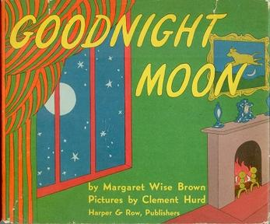
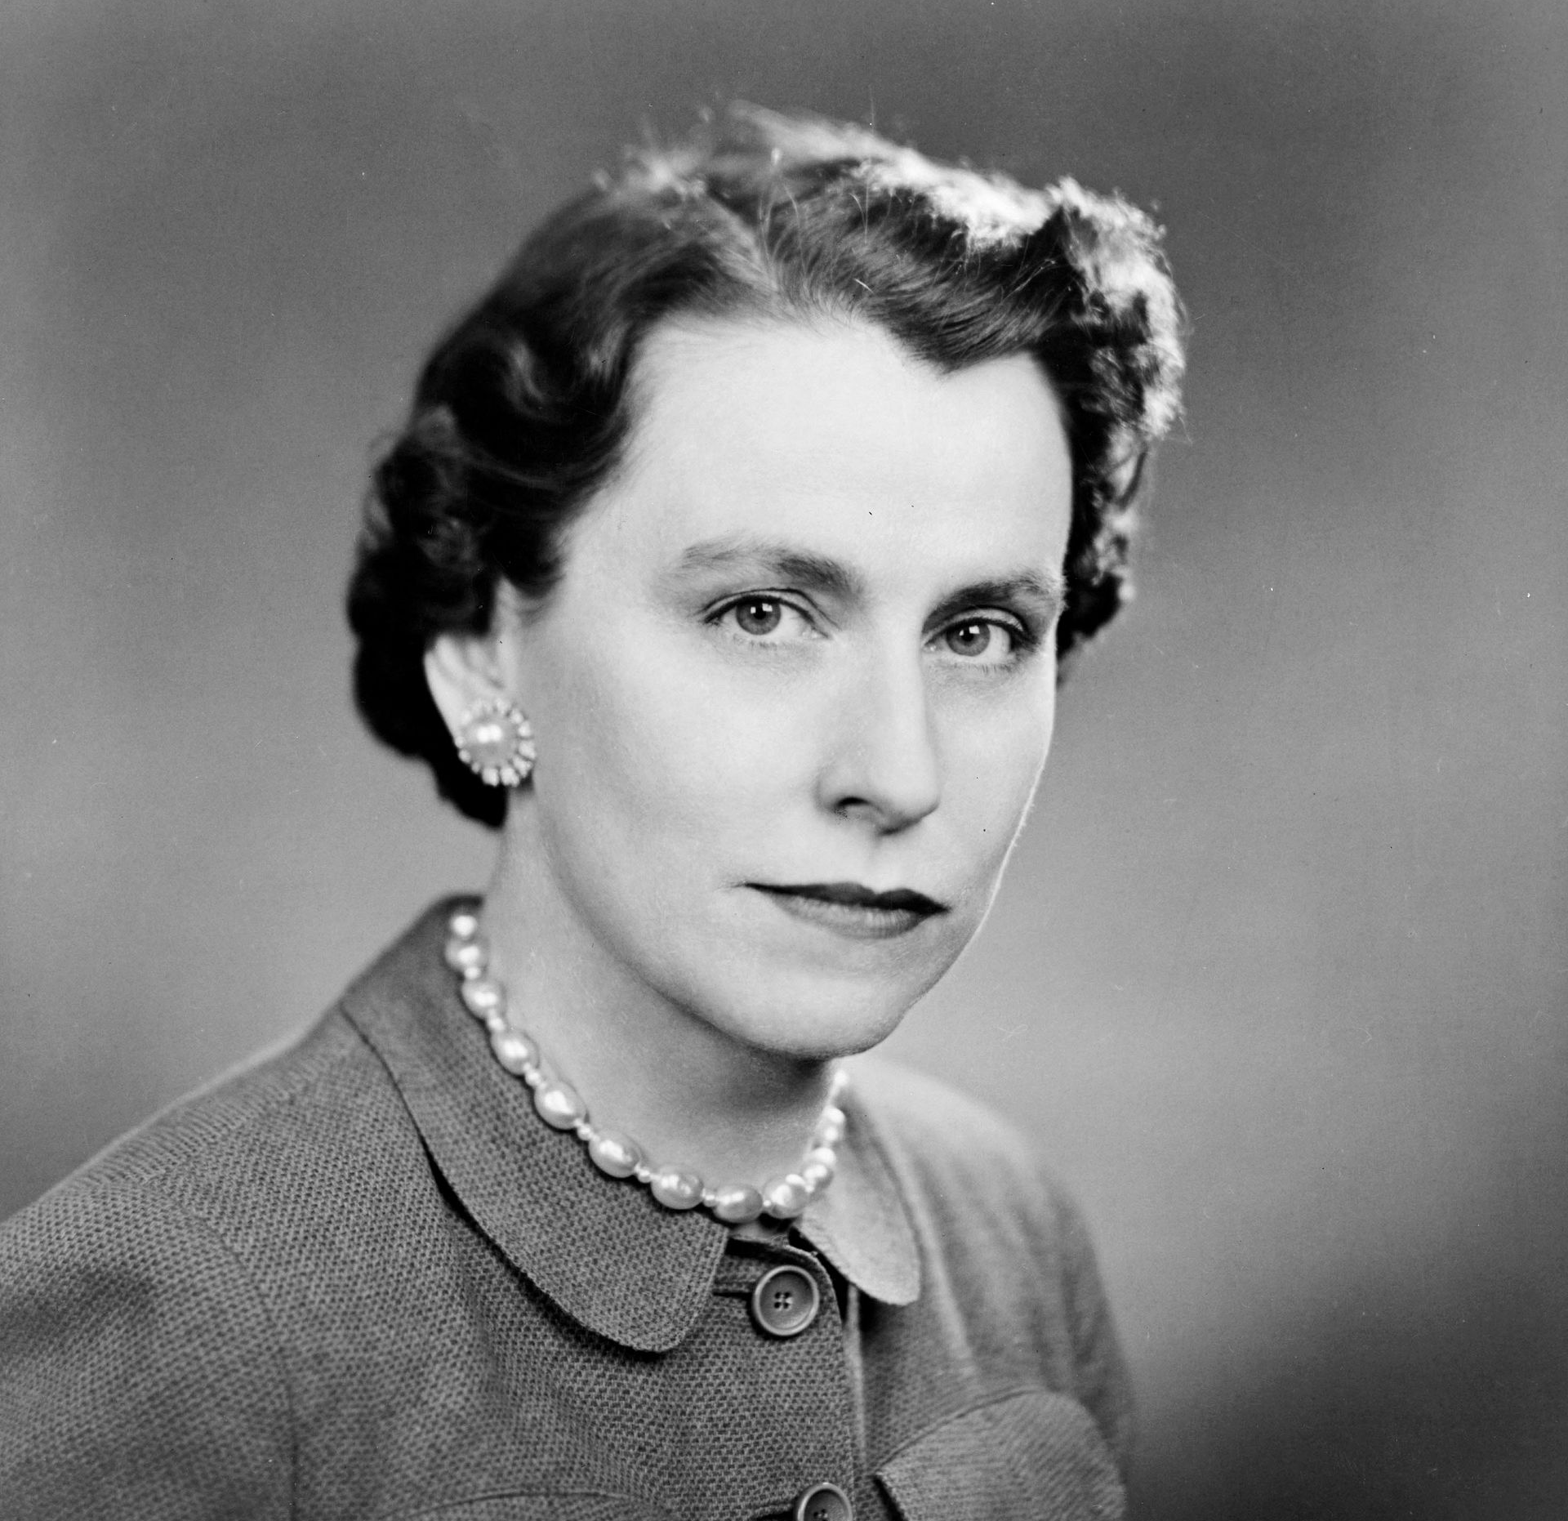
Lucy Sprague Mitchell (1878-1967)
Critical link in American education and early childhood education
Mentors included John Dewey and Edward Thorndike (Educational philosophy meets psychology)
Focus on child development over specific curriculum
Whole child approach
Importance of observation
Role of research and evidence to guide practice
Emphasis on play and experience
Bank Street College
Children’s Literature
Launch for Head Start

Slide 23
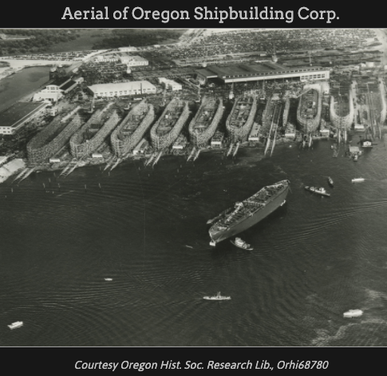
Contributions and Movements
McMillan Sisters
Focus on health and education
Idea of “nursery school” for children under 5.
Works Progress Administration Nurseries (relief nursery model)
Highlighted importance of high-quality care and training
Lanham Act in WWII
Kaiser Shipbuilding company center in Oregon
24 hours/day
Provided health and nutrition services for children and mothers
Parent education
Teacher training
Play-based education

Slide 24
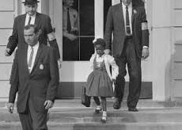
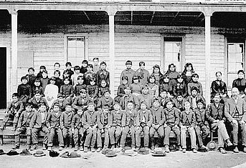
A Wider Lens: A Painful Past
Kaiser included town of Vanport with 42,000 residents, most of which were African American who had moved to the Northwest for positions with the company. Most of Vanport was destroyed by flood in 1948.
Brown v. Board of Education: a landmark 1954 Supreme Court case in which the justices ruled unanimously that racial segregation of children in public schools was unconstitutional. (Ruby Bridges with US Marshals)
American Indian Boarding Schools-The federal government began sending Native Americans, First Nation, and Indigenous Peoples to off-reservation boarding schools in the 1870s, when the United States was still at war with Indians. (Warm Springs Agency Boarding School 1890)

Slide 25
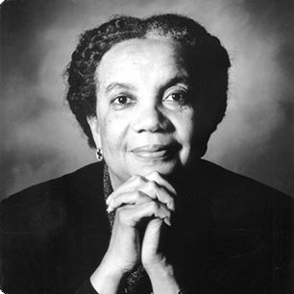
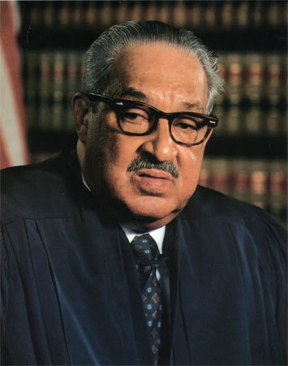
African American and Black American Leaders in Education
Mary McLeod Bethune (1875-1955) Helped to lead HBCUs
Mary Church Terrell (1863-1954) Racial equity in early childhood education
Marian Wright Edelman (1939- Civil Rights Activist and founder of the Children’s Defense Fund)
Thurgood Marshall (US Supreme Court Justice)
Nathan Hare: Black Studies Program
Carter G. Woodson-Black History Month
Fanny Jackson Coppin-Champion for Girls Education
Aaron Lloyd Dixon-Nutritional Support for children
Selena Sloan Butler-NPTA

Slide 26
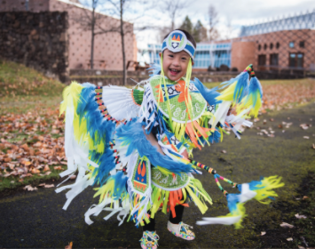
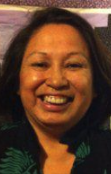
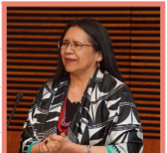
Native American Leadership in Early Learning
Reclaiming history, tradition, voice, and representation
Reconciling painful past and impact on health, social, cultural, and economic well-being
Meriam Report (1928) led to (slow) shift in Indian education toward progressive and culturally responsive practices
1972 Office of Indian Education established and required involvement of families and tribal leaders in setting policies and practices
Debbie Reese of Nambé Pueblo established AICL: American Indians in Children’s Literature (https://americanindiansinchildrensliterature.blogspot.com/)
Local leaders, such as Valerie Switzler of Warm Springs, have been recognized for bringing critical focus to Native language studies and Land Acknowledgement practices.

Slide 27
Purpose: To acknowledge someone is to say, "I see you. You are significant." The purpose of a land acknowledgement is to recognize and pay respect to the original inhabitants of a specific region. It is an opportunity to express gratitude and appreciation to those whose territory you exist in.

Slide 28
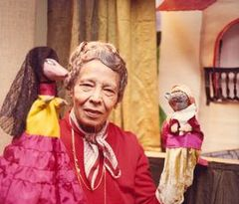
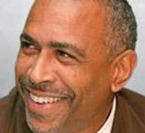
Latinx Leaders in Education
Pura Belpré-Immigrated from Puerto Rico in 1920 and began working with the New York Public Library where she established first bilingual literature programs (ALA honors her work every year)
Sylvia Mendez (Mendez v. Westminster, 1947) led to desegregation in California school system and paved the way for Brown v. Board of Education
Dr. Eugene Garcia-Center for Applied Linguistics with focus on bilingual education and rights
Delia Pompa-Migration Policy Institute with a focus on immigrant rights and access
Dr. Pedro Noguera-Dir. Center of Transformation of Schools at UCLA with a focus on education, social justice, and public policy

Slide 29
Enduring and Often Controversial questions:
What is childhood?
What is the value of childhood in society?
What are the rights of children?
What is the role of education in society?

Slide 30
Lessons from the past
Intentional teaching requires the knowledge and confidence to recognize the why guiding the what.
Developmentally appropriate and culturally responsive practices mean that we remember the who, the children and families in our care.

Slide 31
Looking ahead: “Influential Thinker” assignment
Consider a deeper dive into one of the individuals you’ve heard about this week.
Challenge yourself to go beyond a name already well-known.
Be a part of a more inclusive history!
Focus is on impact and influence of ideas and contributions.
Highlight how individual inspires your own thinking and journey as an educator.

Slide 32
What’s happening next week?
Date | Topic | Before class, please make sure to…
October 14 | Developmentally Appropriate Practice Defining Applying Identifying | Read Chapter 3 Visit Blackboard for brief assignments Field Placement Connection Contracts Time Logs

Slide 33
Have a great week!

